Slide 1
ABP Framework
Lecturer: Ngo Huy Bien
Software Engineering Department
Faculty of Information Technology
VNUHCM - University of Science
Ho Chi Minh City, Vietnam
nhbien@fit.hcmus.edu.vn

Slide 2

Objectives
To learn ABP Framework by yourself.

Slide 3

Contents

Slide 4

References

Slide 5


We Need a Problem First!

Slide 6
Example Needs

Slide 7


Slide 8
1. Install the ABP CLI
ABP CLI is a command-line utility to perform some common tasks for ABP applications.
It is used to create a new solution with ABP Framework as a fundamental functionality.
Install it using a terminal with the following command:
dotnet tool install -g Volo.Abp.Cli
dotnet tool update -g Volo.Abp.Cli

Slide 9
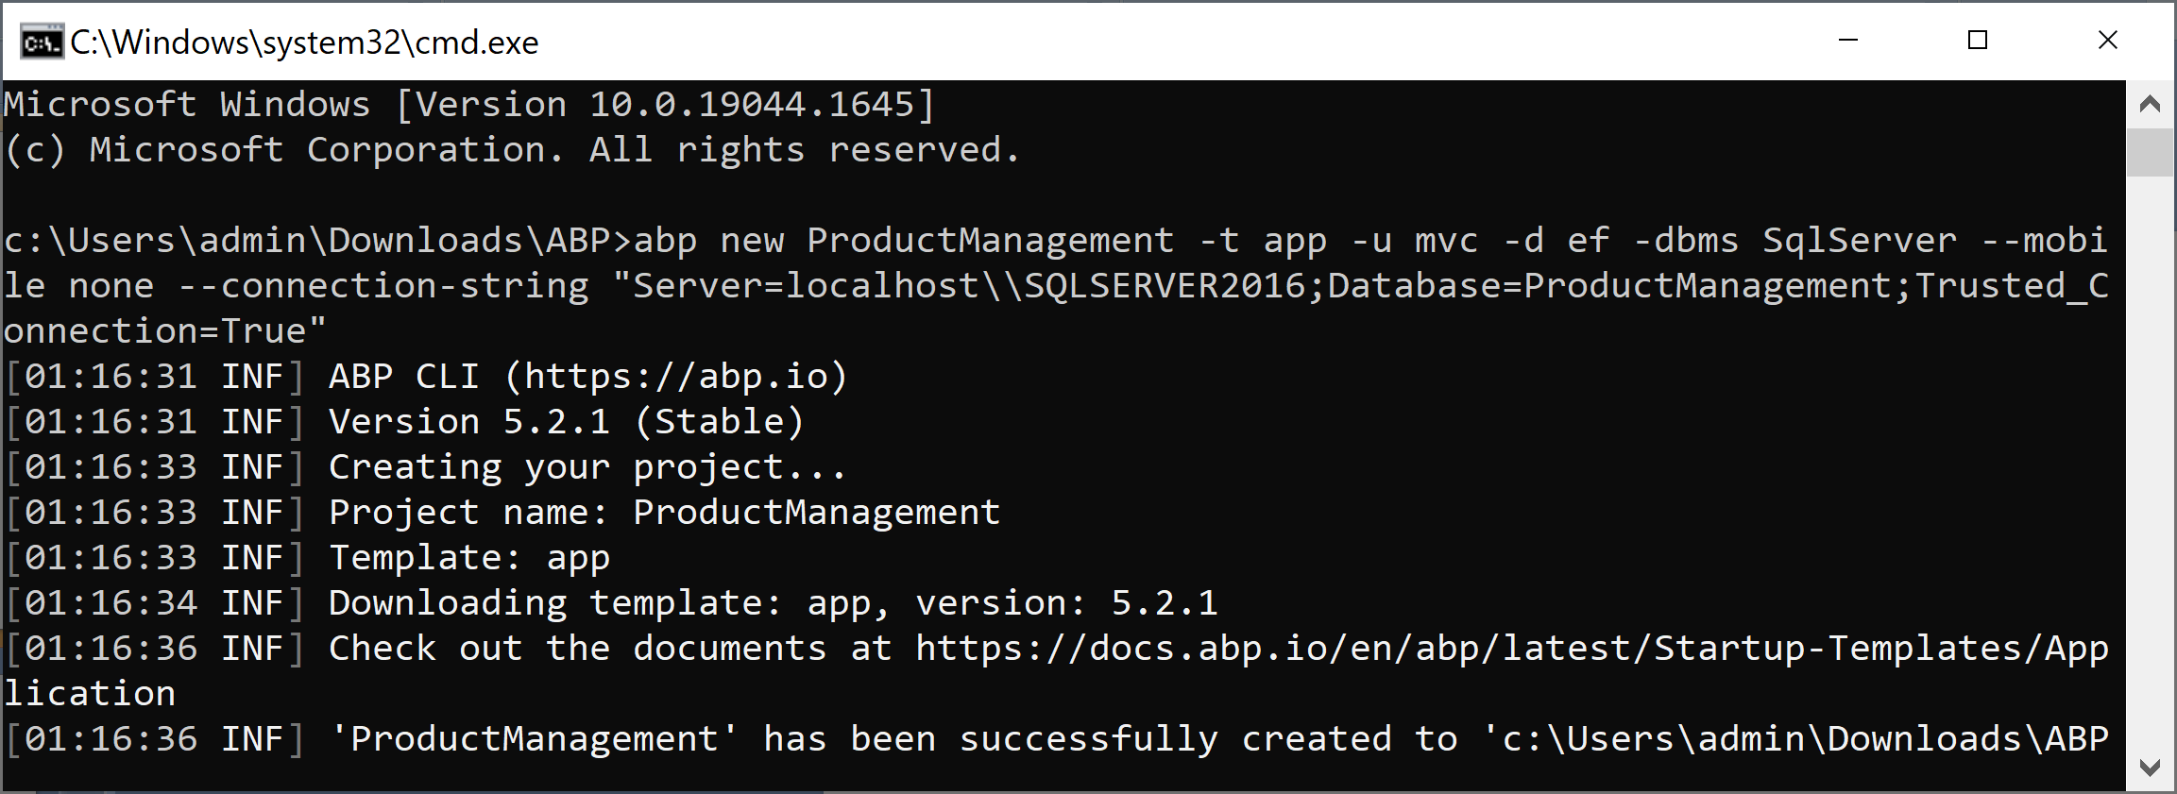
2. Create a New Solution
abp new ProductManagement -t app -u mvc -d ef -dbms SqlServer --mobile none --connection-string "Server=localhost\\SQLSERVER2016;Database=ProductManagement;Trusted_Connection=True"

Slide 10
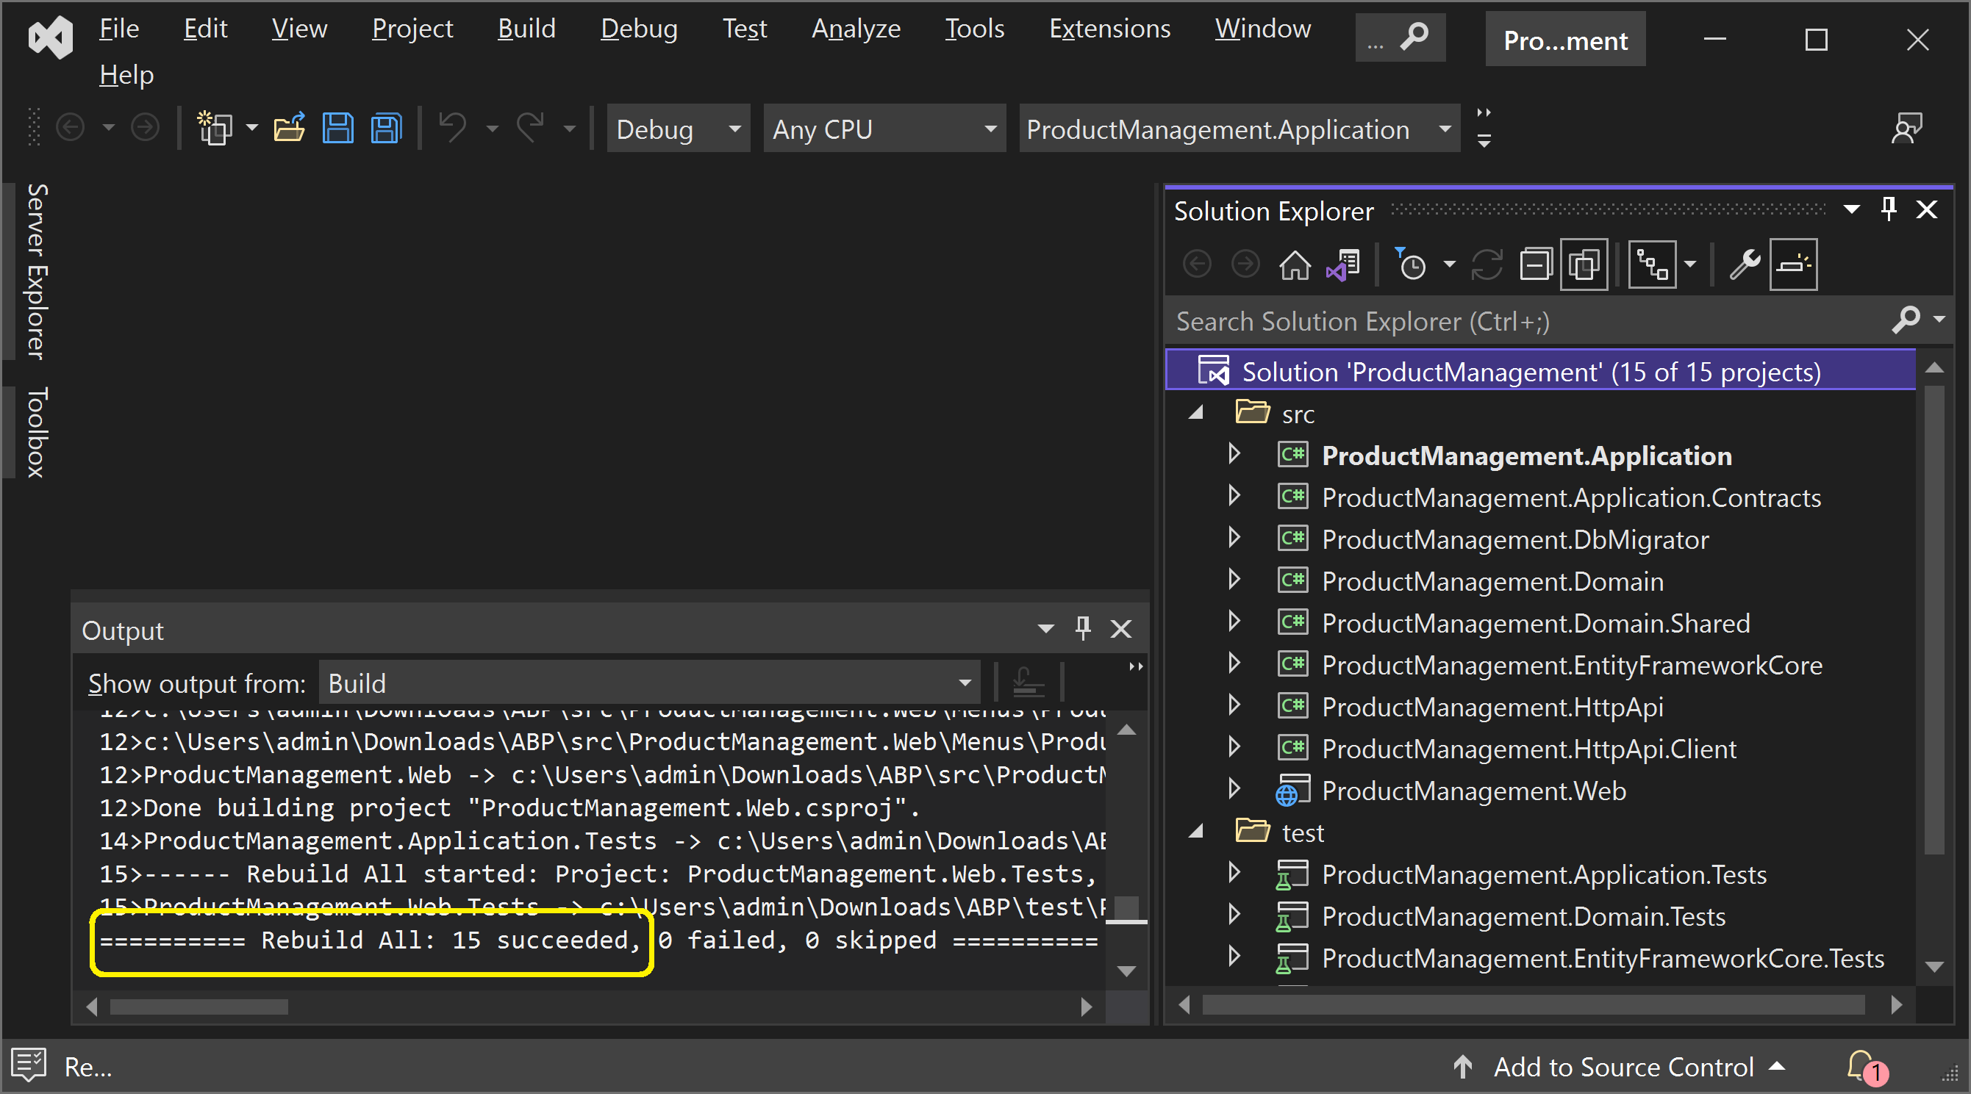
3. Rebuild the Solution

Slide 11
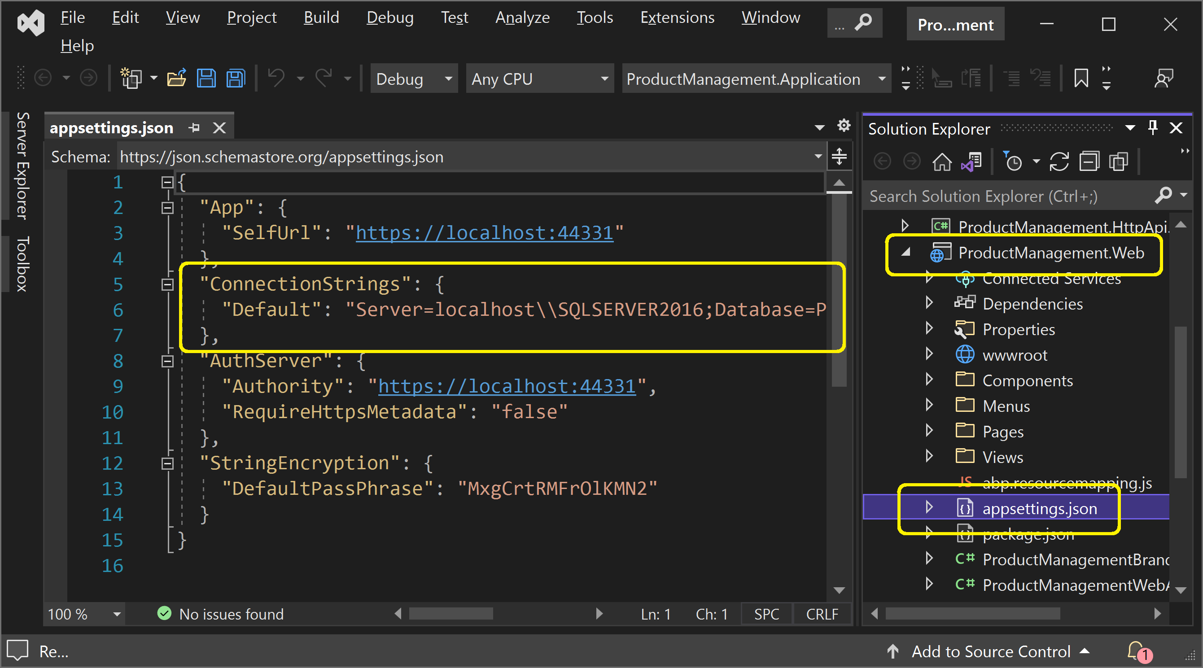
4. Review the Connection String (I)

Slide 12
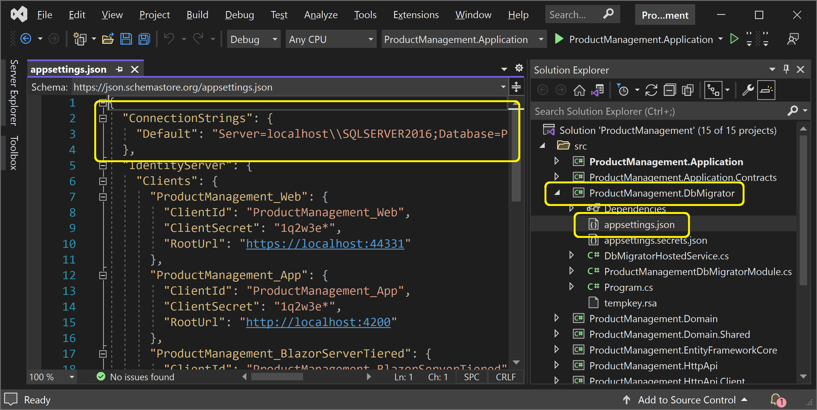
4. Review the Connection String (II)

Slide 13
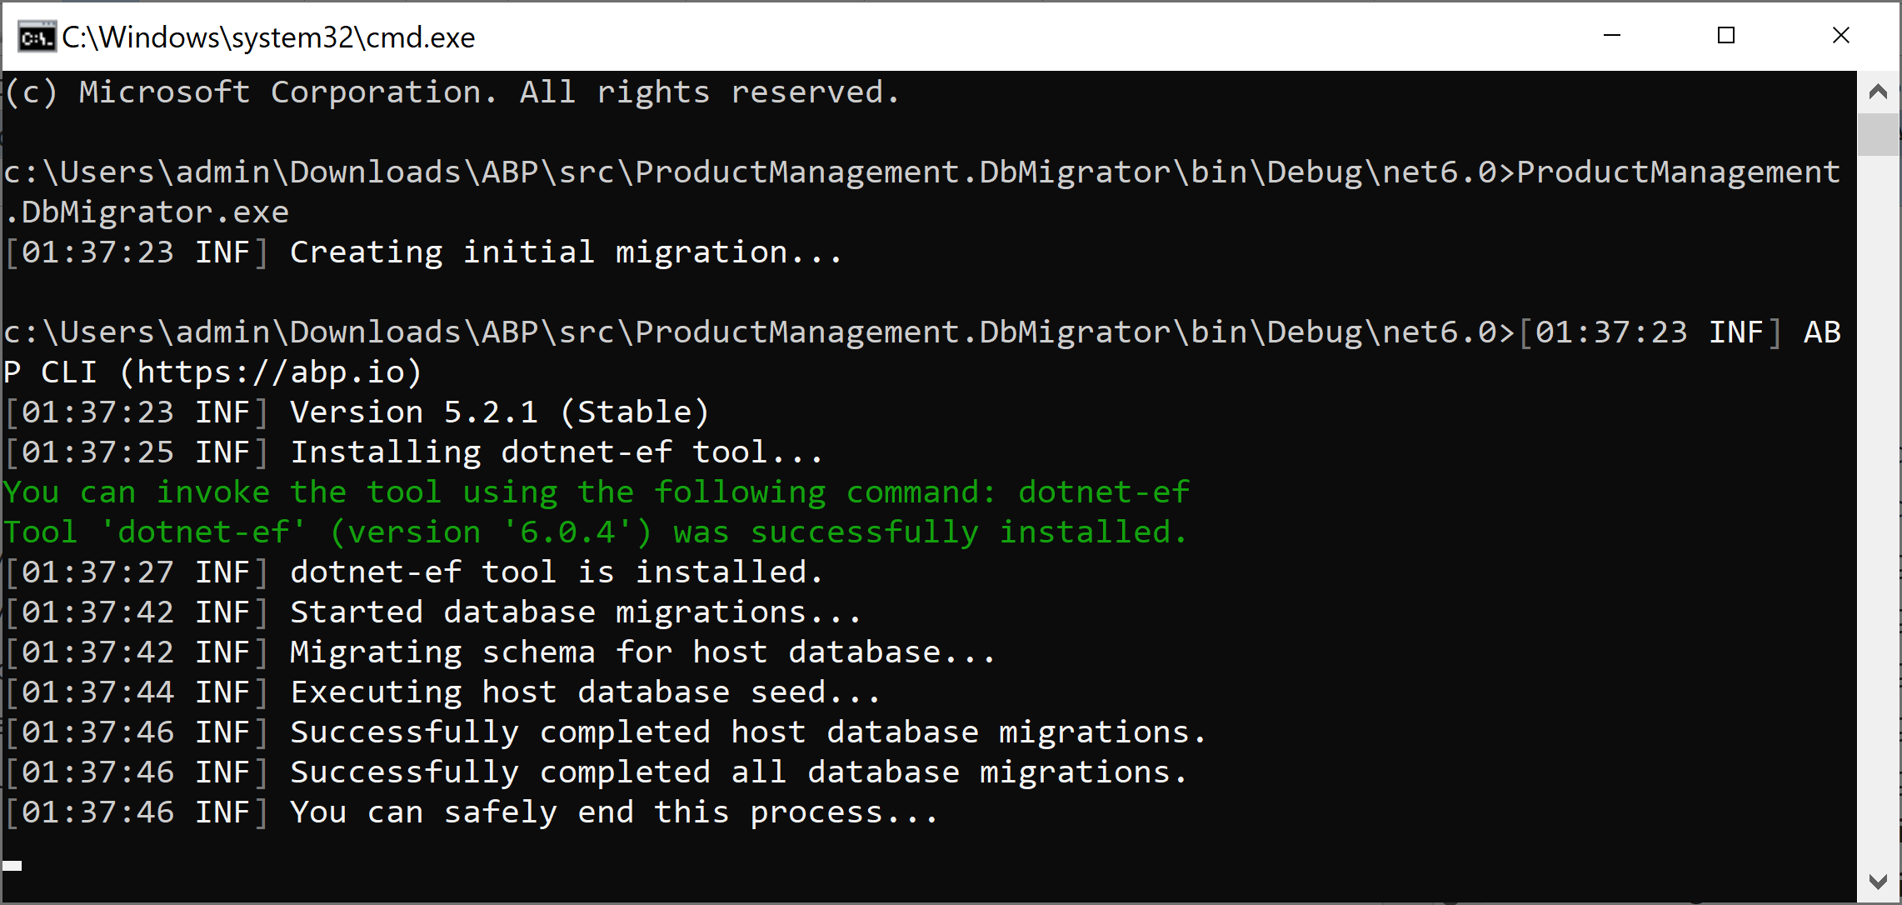
5. Create the Database
Execute ProductManagement.DbMigrator.exe

Slide 14
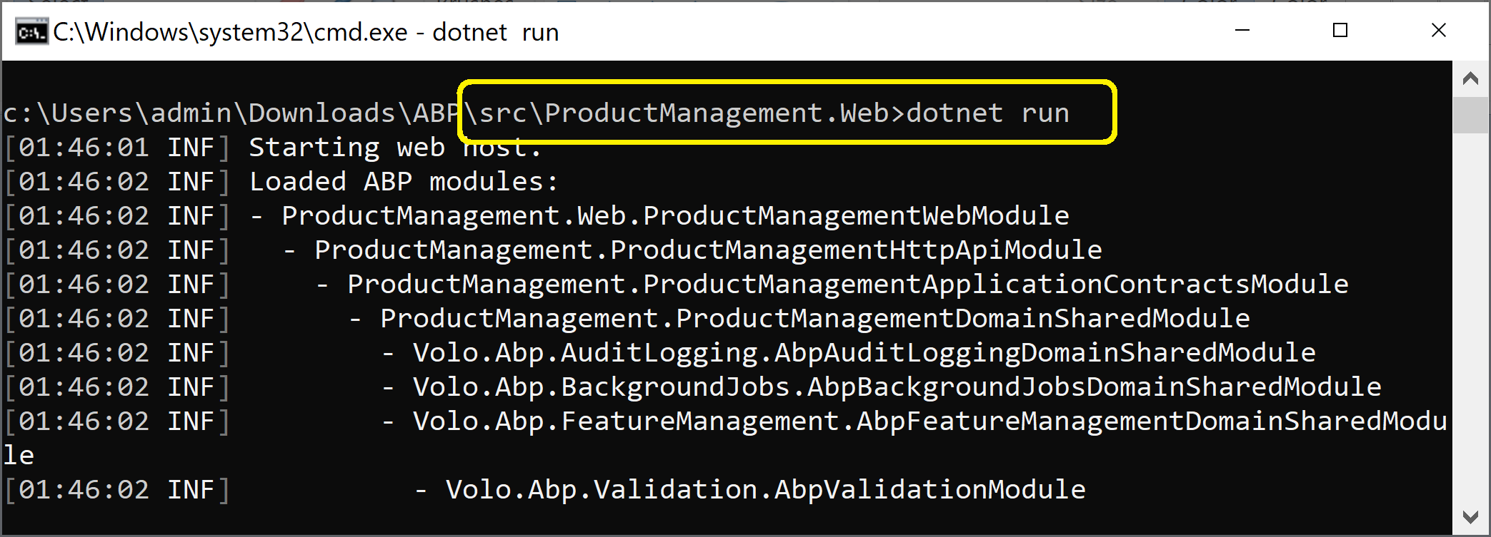
6. Run the Web Application (I)
dotnet run

Slide 15
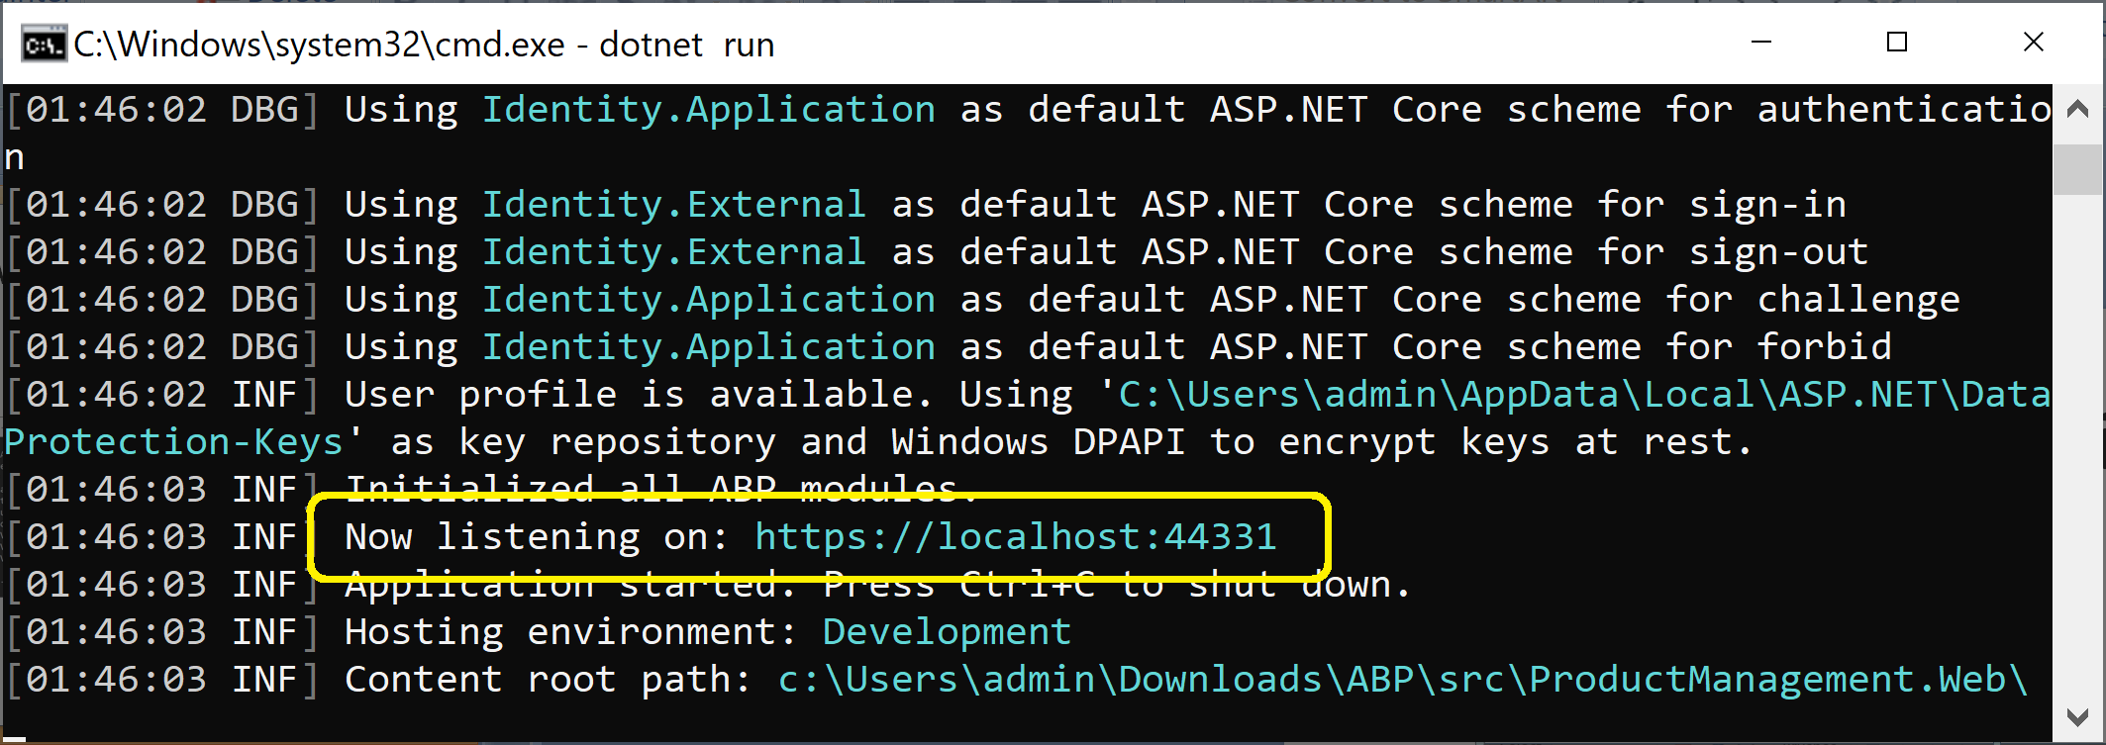
6. Run the Web Application (II)

Slide 16
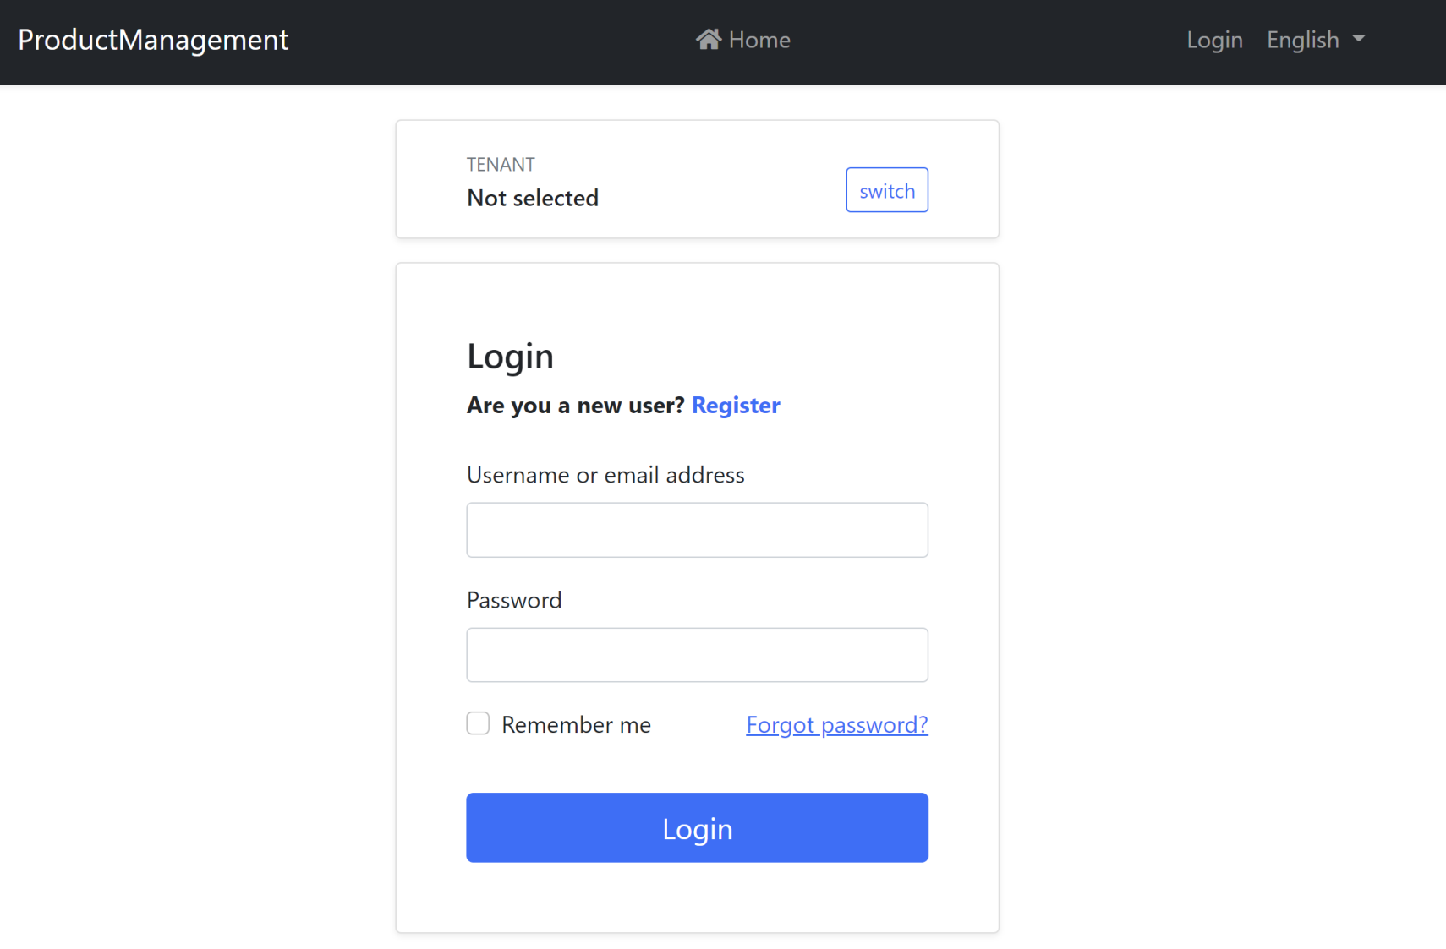
7. Open the Web Application
https://localhost:44331/Account/Login
admin / 1q2w3E*

Slide 17

Thank You & See You Again

